Slide 1


OOP2 Project
Students names :
Layan Kandil
Maryam Alotaibi
Deema Alshehri

Slide 2

Problem Description
Most of the students who are attending the university suffer from walking from one building to another, where they have to go a long way under the sun to get to the other building. So they are mostly very tired upon arriving and might sometimes arrive late to the next lecture.
Our Program Helps the Students to reserve transport from the application to ease their journey from one building to another.

Slide 3
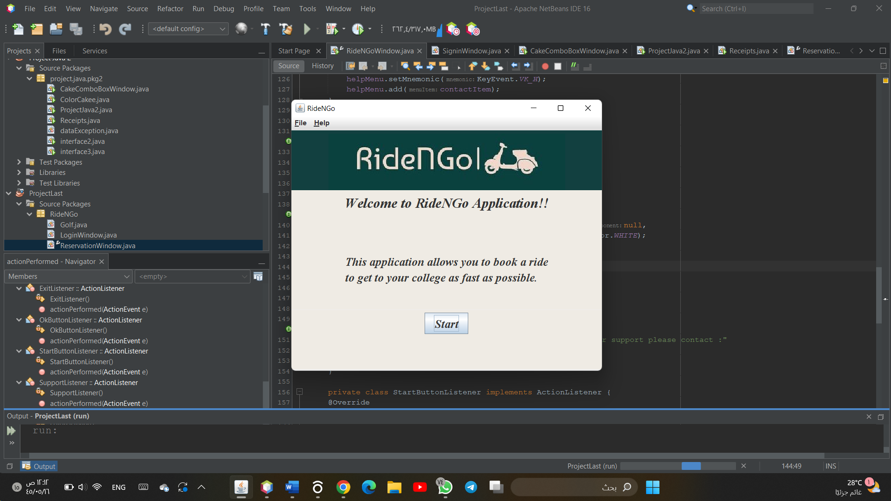
Application Description
In The beginning, the program will welcome the students to the application and give them a brief description

Slide 4
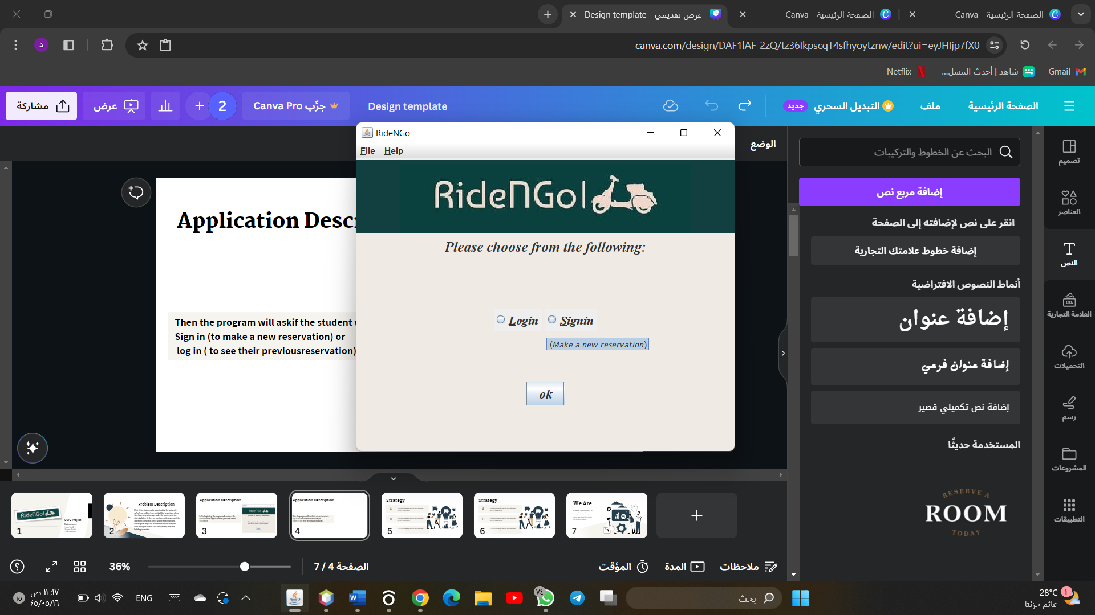
Application Description
Then the program will ask if the student wants to
Sign in (to make a new reservation) or
log in ( to see their previousreservation).

Slide 5
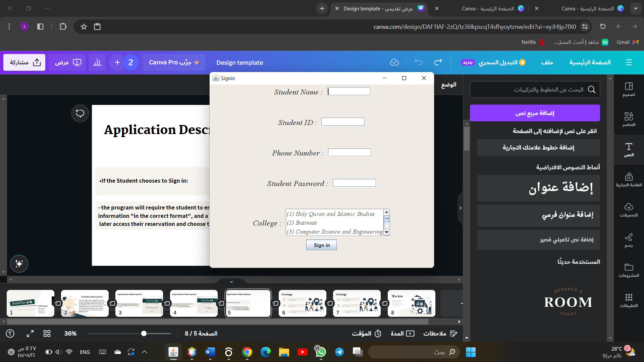
Application Description
•If the Student chooses to Sign in:
- the program will require the student to enter their information "in the correct format", and a password to
later access their reservation and choose their college

Slide 6
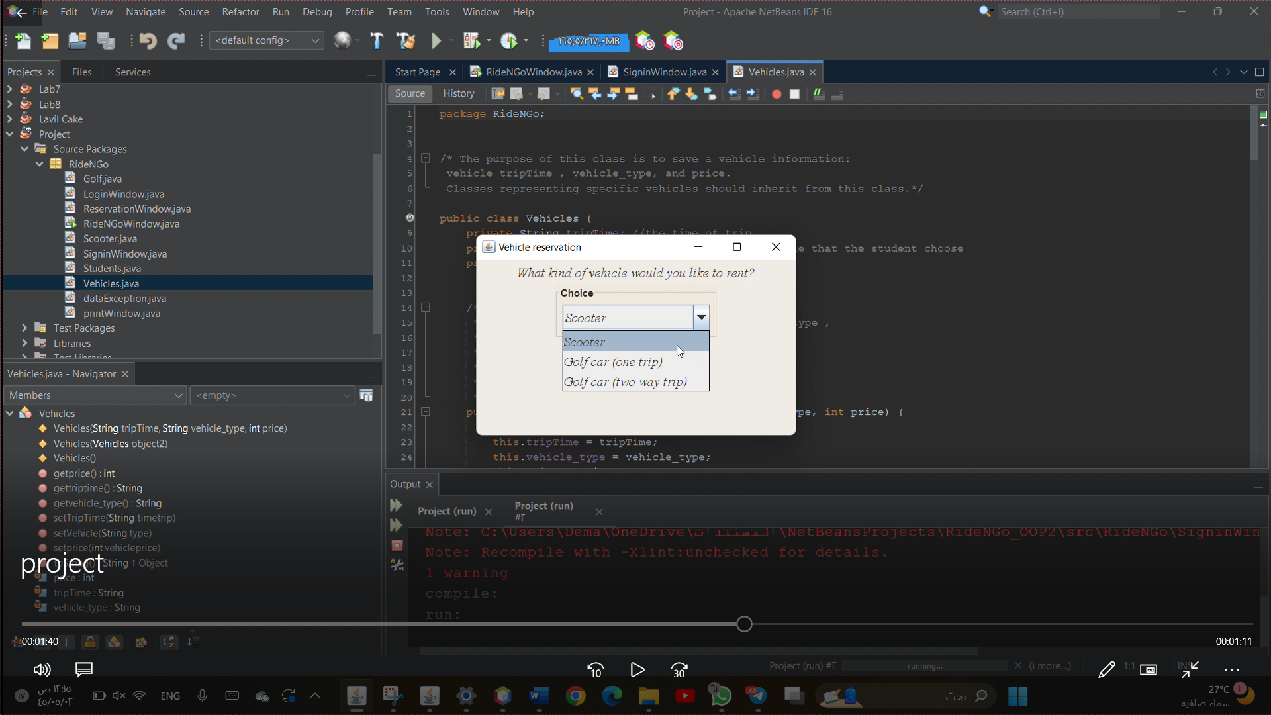
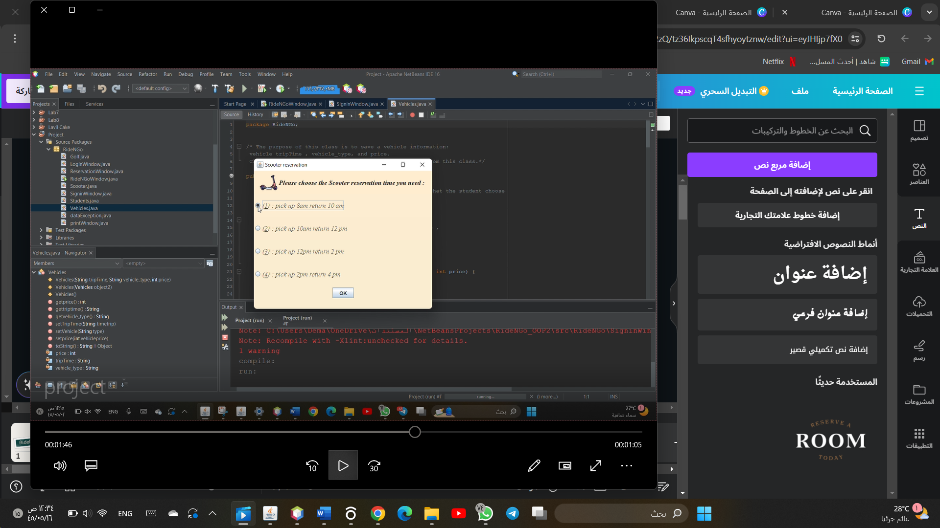
Application Description
Then the student must choose the vehicle they want to reserve and the time they need it.

Slide 7
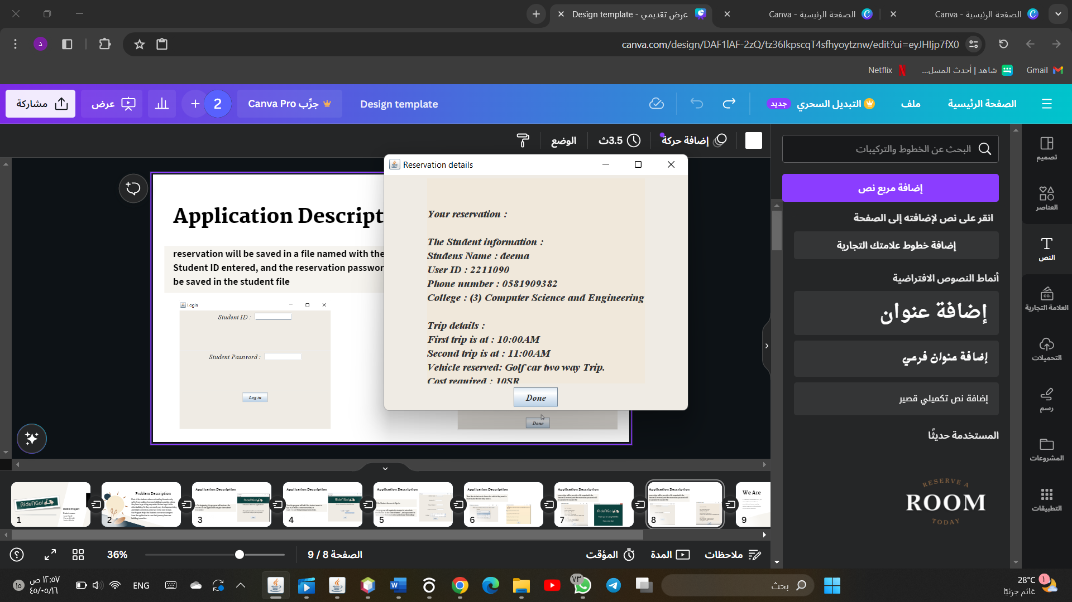
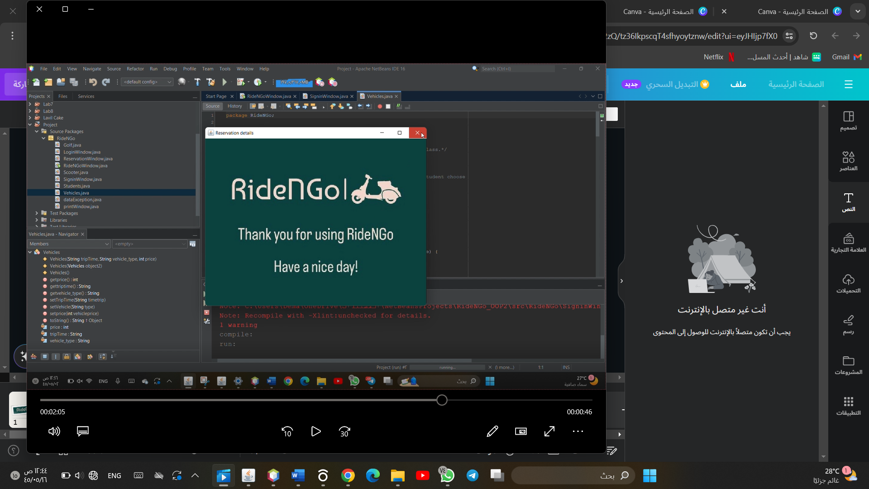
Application Description
Finally, the program will display all the reservation details and then a final image window thanking the student for using our application and that’s The End of the program.

Slide 8
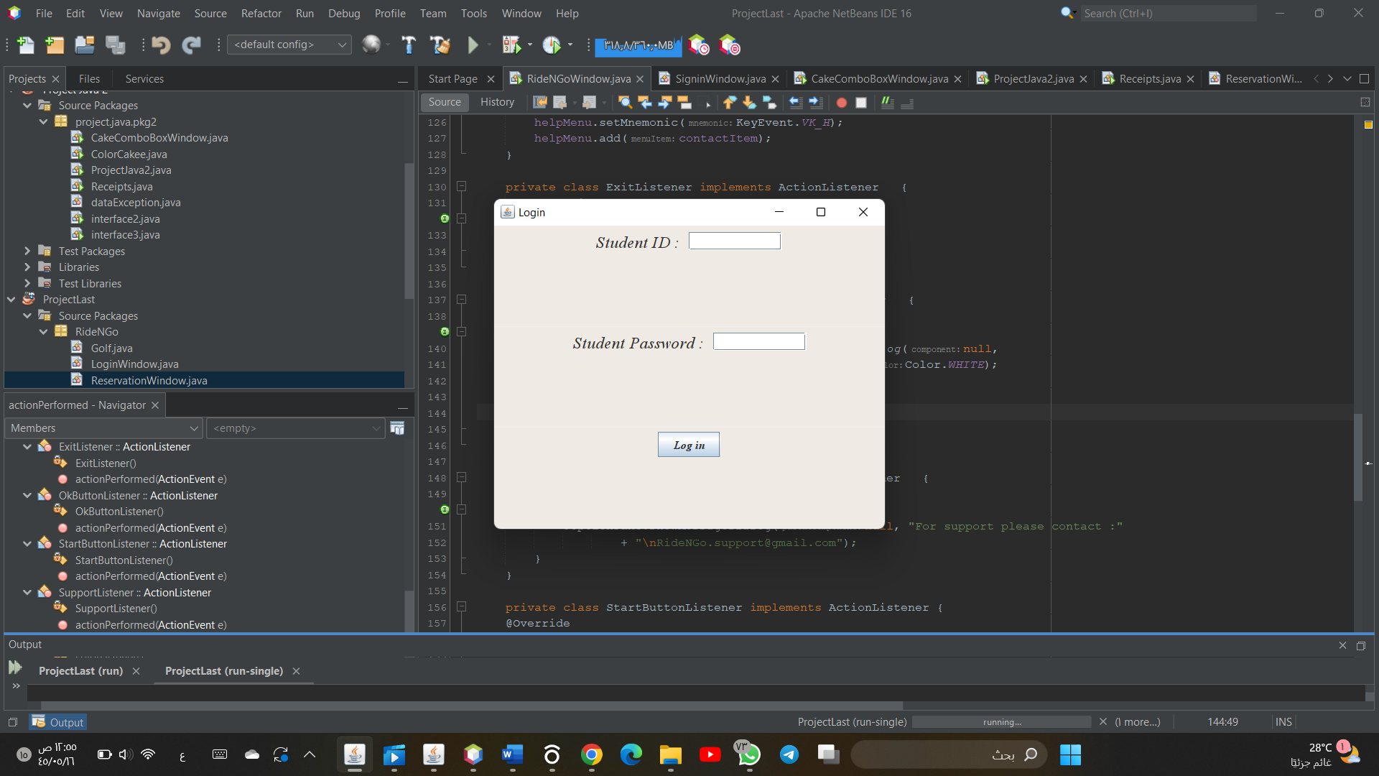
Application Description
•If the Student chooses to Log in :
-The program will ask the student for the ID and
password and check if the reservation exists and if the
password is correct. then it displays all the reservation details then the final than you image window

Slide 9
The End
Thank you!

